Slide 1


Slide 2
Cache Working Principle:

Slide 3
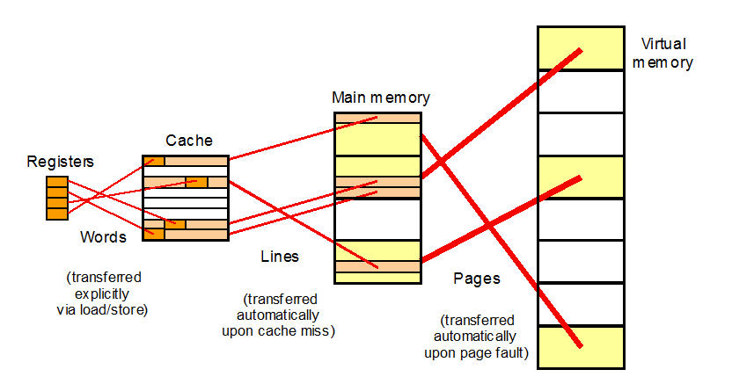
Principle of Working : Cache

Slide 4
Cache operation – overview
CPU requests contents of memory location
Check cache for this data
If present, get from cache (fast)
If not present, read required block from main memory to cache.(slow)
Then deliver from cache to CPU
Cache includes tags to identify which block of main memory is in each cache slot.

Slide 5
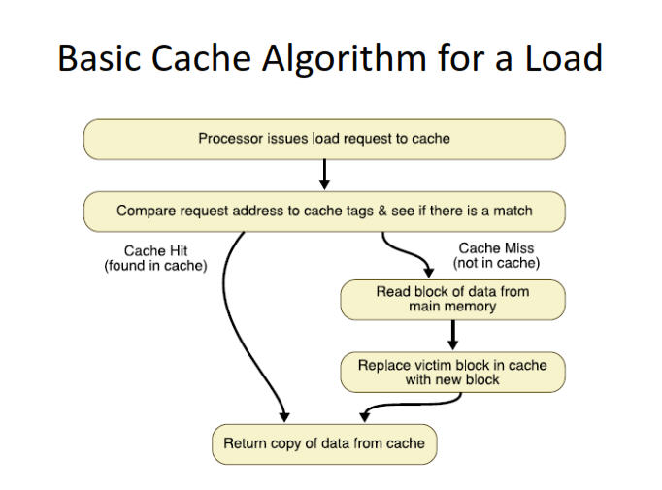
Example :

Slide 6
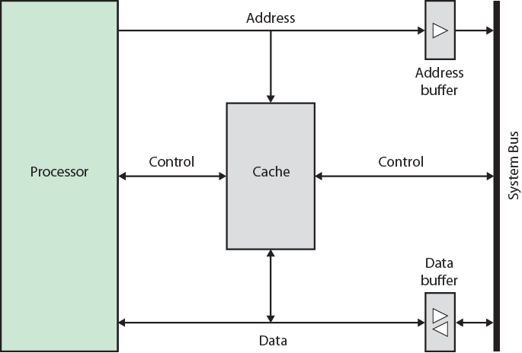
Typical Cache Organization :

Slide 7
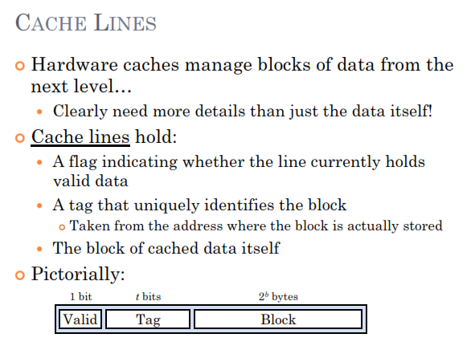
Cache Structure : Cache lines

Slide 8
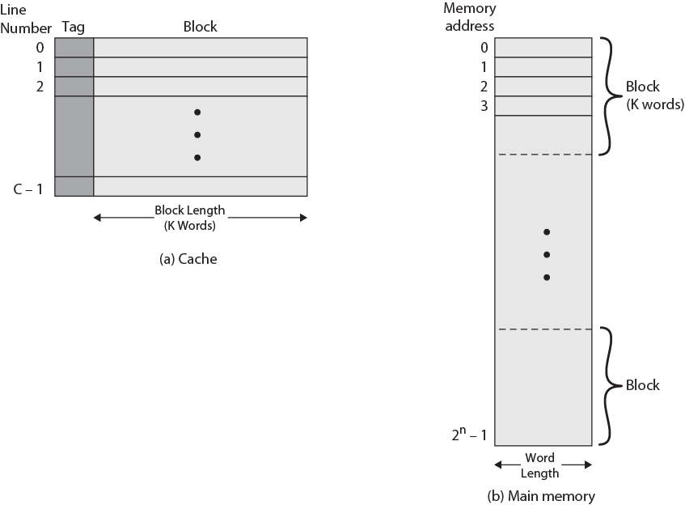
Cache/ Main Memory Structure :

Slide 9
Cache Miss - Hits:

Slide 10
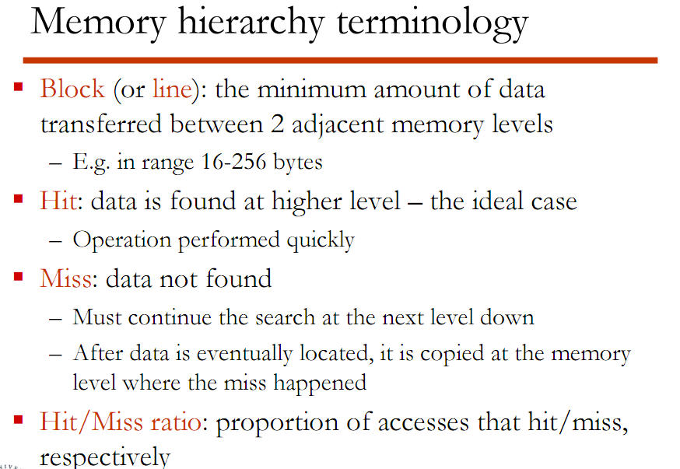
Cache Miss – Hits:

Slide 11
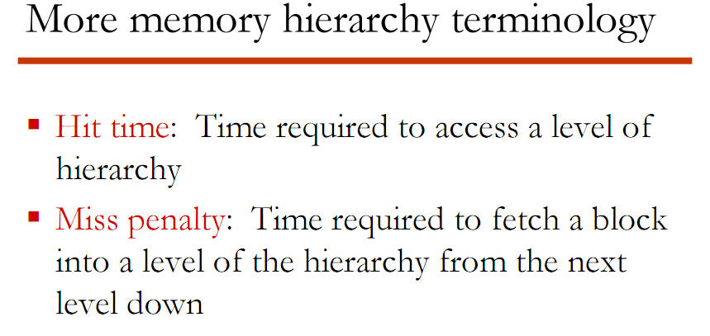
Cache Miss – Hits:

Slide 12
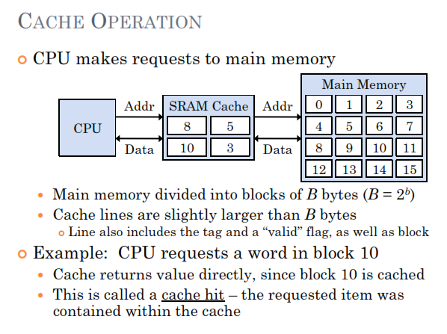
Cache Hit : Detailed

Slide 13
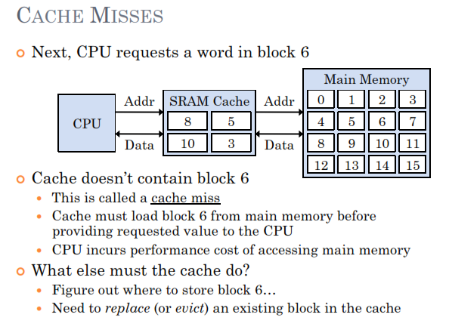

Cache Miss : Detailed

Slide 14
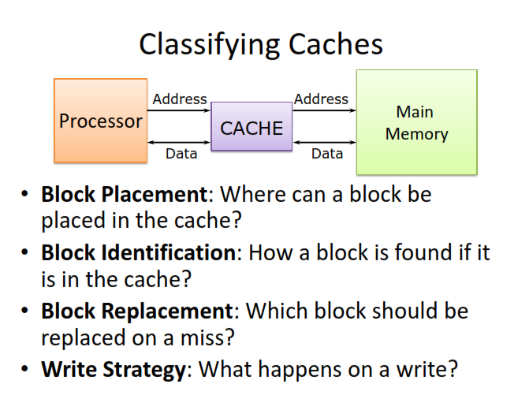
Challenges in Cache :

Slide 15

Challenges in Cache :
Cache Placement & Replacement Policy

Slide 16
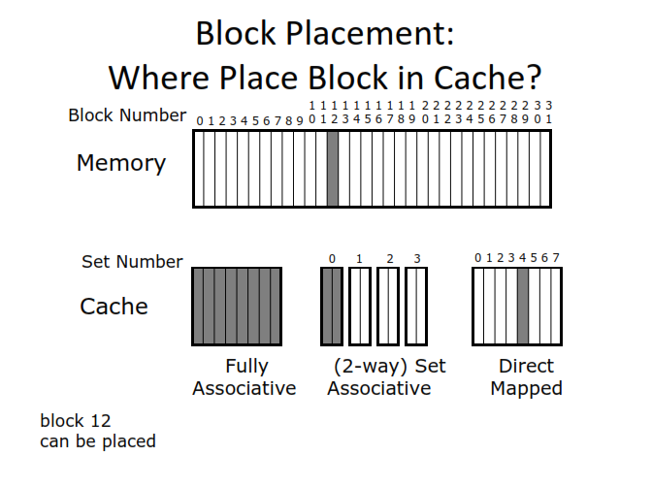
Block Placement :

Slide 17
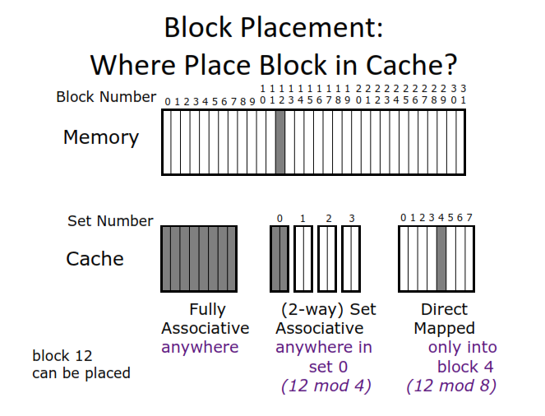
Block Placement :

Slide 18
Block Identification :
Which block is loaded from memory to cache is identified on the basis of Cache Tags.

Slide 19
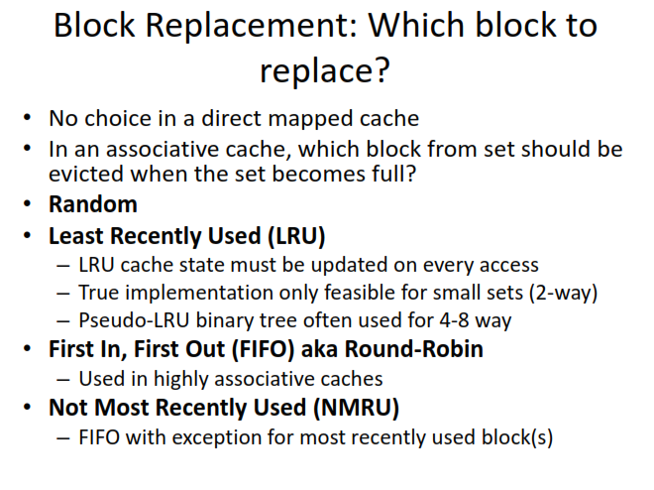
Block Replacement :

Slide 20
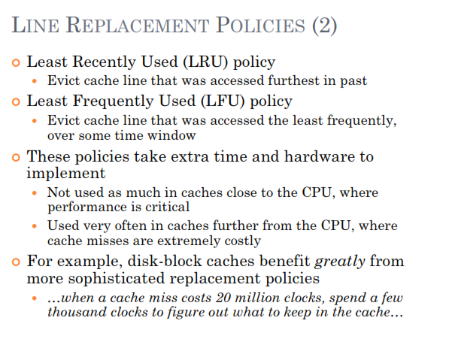
Block Replacement :

Slide 21
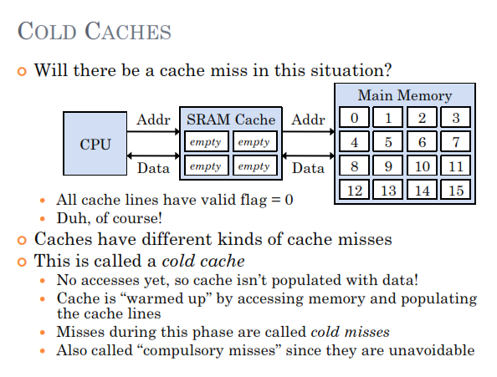
Cache Miss [ 1 of 3 ]: The Three C’s

Slide 22
Cache Miss[ 2 of 3 ]: The Three C’s

Slide 23
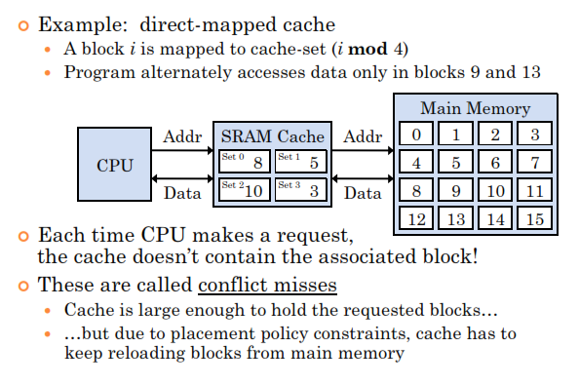
Cache Miss[ 3 of 3 ]: The Three C’s
Conflict :

Slide 24
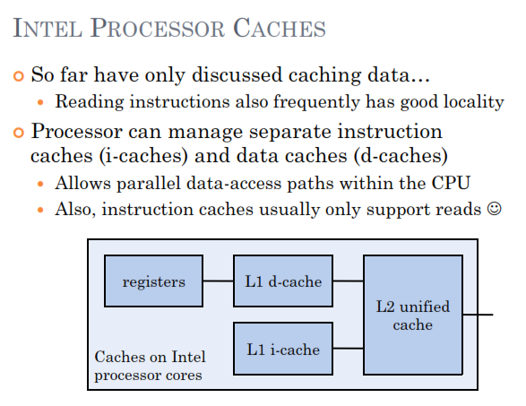
Specialized Caches :
Separate cache for data and instructions:

Slide 25
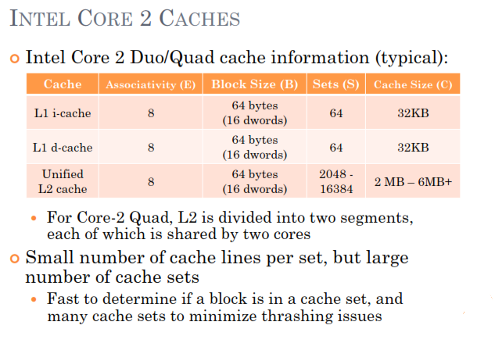
Specialized Caches :

Slide 26
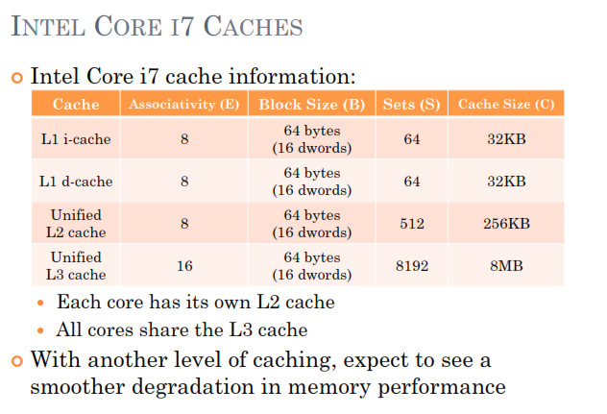
Specialized Caches :

Slide 27
Specialized Caches :
Victim cache:
A victim cache is a cache used to hold blocks evicted from a CPU cache upon replacement. The victim cache lies between the main cache and its refill path, and only holds blocks that were evicted from the main cache.
The victim cache is usually fully associative, and is intended to reduce the number of conflict misses.

Slide 28
Writing to Caches :

Slide 29
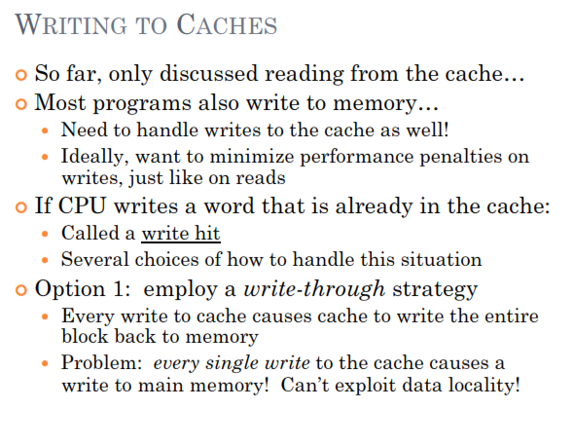
Writing to Cache :

Slide 30
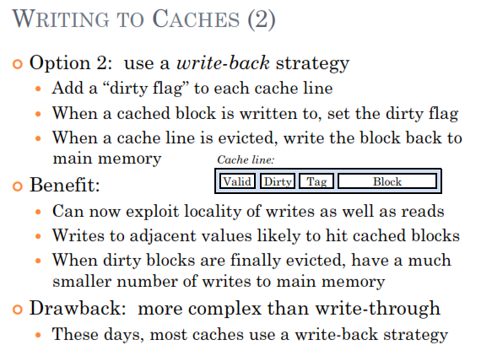
Writing to Cache :

Slide 31
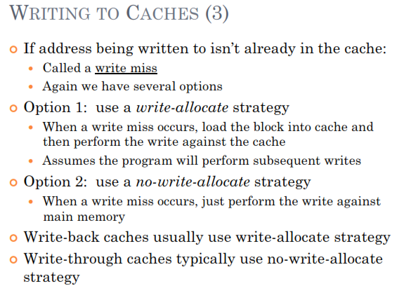

Slide 32

Cache Questionnaire:

Slide 33
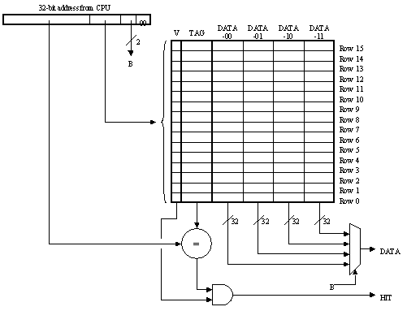
Question 01:
Cache
Direct mapped
32 bit data word
32 bit byte address
Q1 : What is the maximum number words of data from main memory that can be stored in the cache at any one time?

Slide 34
Answer 01:
Cache
Direct mapped
32 bit data word
32 bit byte address
Answer to Q1 :
Maximum number of data words from main memory = (16 lines)(4 words/line) = 64 words
What is its capacity in bytes???

Slide 35
Question 02:
Cache
Direct mapped
32 bit data word
32 bit byte address
Q2 : How many bits of the address are used to select which line of the cache is accessed?

Slide 36
Answer 02:
Cache
Direct mapped
32 bit data word
32 bit byte address
Answer to Q2 : ( 4 bits )
With 16 cache lines, 4 bits of the address are required to select which line of the cache is accessed.

Slide 37
Question 03:
Cache
Direct mapped
32 bit data word
32 bit byte address
Q3 :How many bits wide is the tag field?

Slide 38
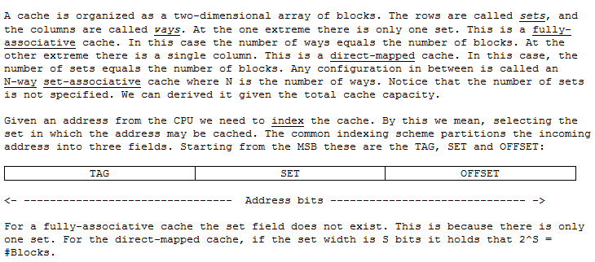
Cache addressing :

Slide 39
Example 01: Cache addressing
A computer uses 32-bit byte addressing & has 2-way associative cache with capacity of 32KB whereas cache block is 16 bytes.
Problem : Calculate the number of bits in the TAG, SET, and OFFSET fields of a main memory address.
Solution: Offset is determined from block size(16 bytes) i.e.
2^4 = 16 bytes.(OFFSET = 4 bits only)
SET Field: It’s a 2-way associative cache so each set contains 2 cache blocks (2x16=32 bytes).so
total sets = 32kB/32 = 1K =2^10 hence (set = 10 bits)
Tag field = total address size – set – offset
= 32 – 10 – 4 = 18 bits

Slide 40
Example 02: Cache addressing
1MB cache, with 64B block size , 4-way set-associative, write-through with FIFO replacement. Assume a 36-bit byte-addressable address space.
Problem : Calculate the number of bits in the TAG, SET, and OFFSET fields of a main memory address.
Solution: Offset is determined from block size(64 bytes) i.e.
2^6 = 64bytes.(OFFSET = 6 bits only)
SET Field: It’s a 4-way associative cache so each set contains 4 cache blocks (4x64=256 bytes).so
total sets = 1MB/256 = (1024*1024)/256 =4096=2^12 hence (set = 12 bits)
Tag field = total address size – set – offset
= 36 – 12 – 6 = 18 bits

Slide 41
Answer 03:
Cache
Direct mapped
32 bit data word
32 bit byte address
Q3 :How many bits wide is the tag field?
Bits in the tag field = (32 address bits) - (4 bits to select line) - (4 bits to select word/byte) = 24 bits

Slide 42
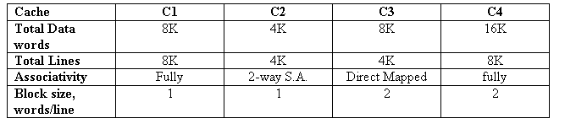
Question 04:
Q5 :
Which cache is likely to perform worst in a benchmark involving repeated cycling through an array of 6K integers ? Explain
C2 would likely have the worst performance on a benchmark involving repeated cycling through an array of 6K integers since it is the only cache listed with less than 6K data word capacity.

Slide 43
Thanks All

